Slide 1
Installation Guide
(Build Tool – Ant 1.7.1)
2009. 01. 06
CODELABOR
Shin Sang Jae (codelabor@gmail.com)

Slide 2
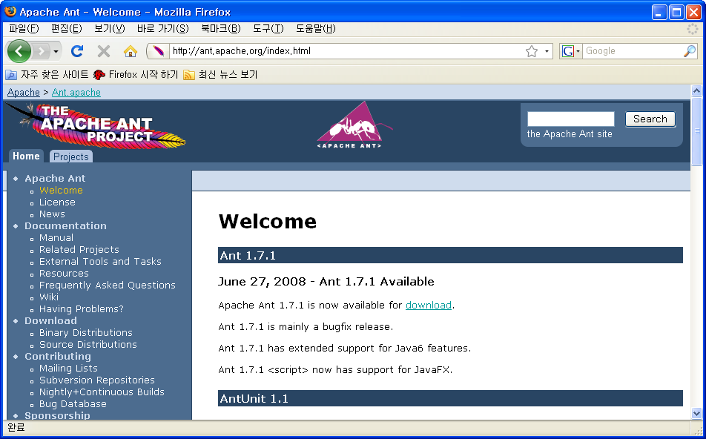

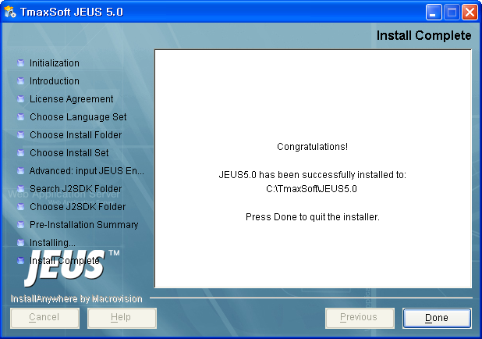
Build Tool
Installation
Official Site URL: http://ant.apache.org
Download Site URL: http://ant.apache.org/bindownload.cgi
File: apache-ant-1.7.1-bin.zip
Extract Directory: C:\Program Files\Apache Software Foundation\apache-ant-1.7.1

Slide 3
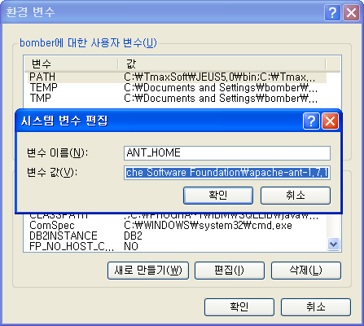
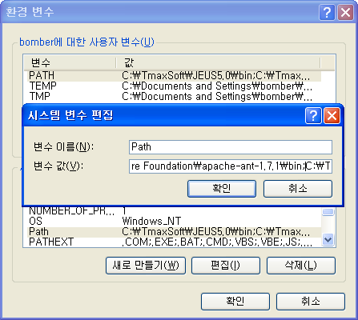
Build Tool
Configuration
Environment Variable
  Set ANT_HOME: C:\Program Files\Apache Software Foundation\apache-ant-1.7.1
  Add PATH: C:\Program Files\Apache Software Foundation\apache-ant-1.7.1\bin

Slide 4
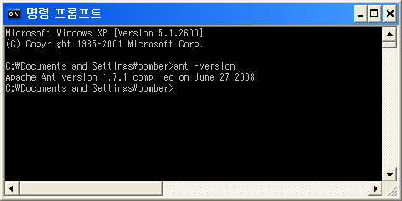
Build Tool
Configuration
Version
  Execute ant -version

